Slide 1
AI Resume
AI
Screening Agent
(n8n)
SCTP Agentic AI Capstone
Presented by Sylvester Ang
n8n · Mistral AI · Groq · Google Sheets · Gmail

Slide 2
Project Objective
Why It Matters
Eliminates repetitive screening tasks
Build an AI-powered resume screening agent using n8n that automates CV analysis and candidate evaluation — reducing manual hiring effort and improving screening accuracy.
Consistent, unbiased evaluation criteria
Instant candidate scoring & feedback
Automate
Evaluate
Notify
Seamless integration with Google Sheets
CV collection & analysis
AI scoring & ranking
Email results & store data
2

Slide 3
What the Agent Can Do
6-Step
Pipeline
01
02
Collect
Extract
Candidate name, email & CV via web form
OCR parses CV text from PDF
1. Form Input
2. OCR Parse
03
04
Evaluate
Decide
3. AI Eval
AI scores candidate against job requirements
IF score > 0.6 → PASS, ELSE → FAIL
4. IF Logic
05
06
Store
Notify
5. Sheets
Results saved to Google Sheets
Email sent with evaluation results
6. Gmail
3

Slide 4
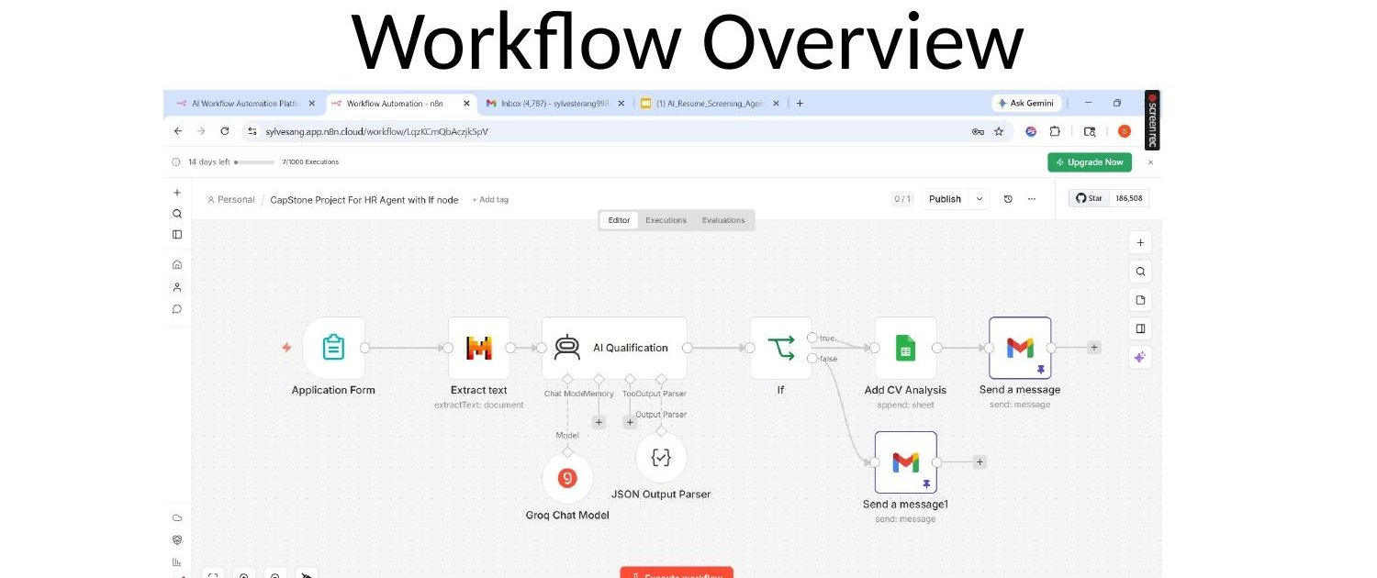
Workflow Overview
Flow Summary
n8n orchestrates all workflow steps
Mistral OCR extracts CV text from PDF
Groq LLM evaluates candidate suitability
IF node routes PASS/FAIL candidates
PASS → Google Sheets + Gmail notify
Form → OCR → AI Qualify → IF → Sheets + Email
4

Slide 5
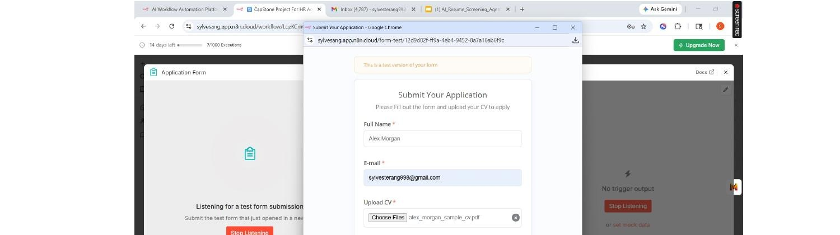
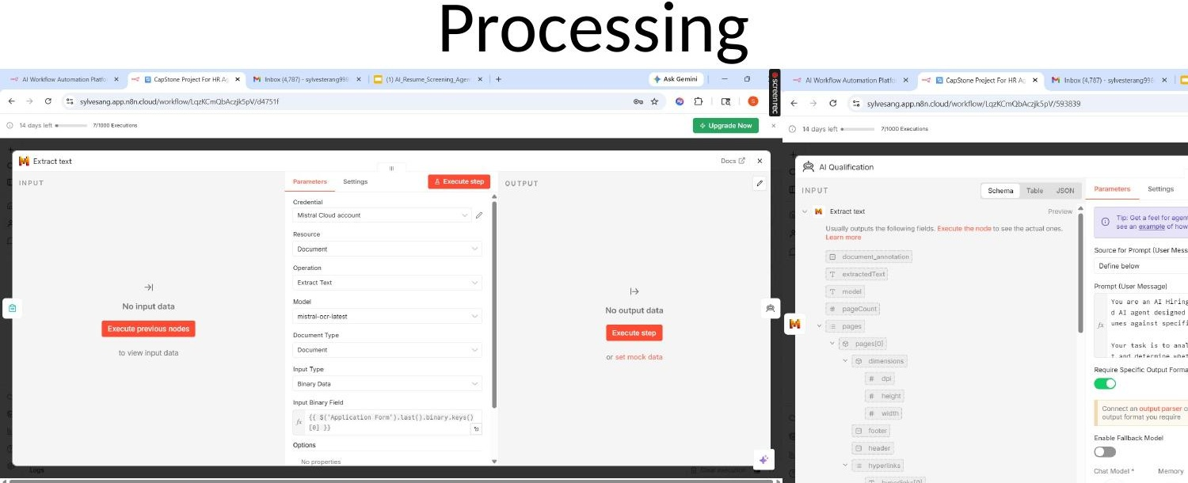
Input → Processing → Output
Data Flow
1
Web Form → n8n trigger
2
PDF → Mistral OCR → text
3
Text → Groq LLM → JSON score
Input: Web Form
Processing: OCR + AI
INPUT
PROCESS
OUTPUT
4
JSON → IF node → route
Name, Email, CV
OCR → text
PASS / FAIL
5
Route → Sheets + Email
via n8n web form
AI scores 0–1
Sheets entry
PDF upload
JSON output
Gmail sent
5

Slide 6
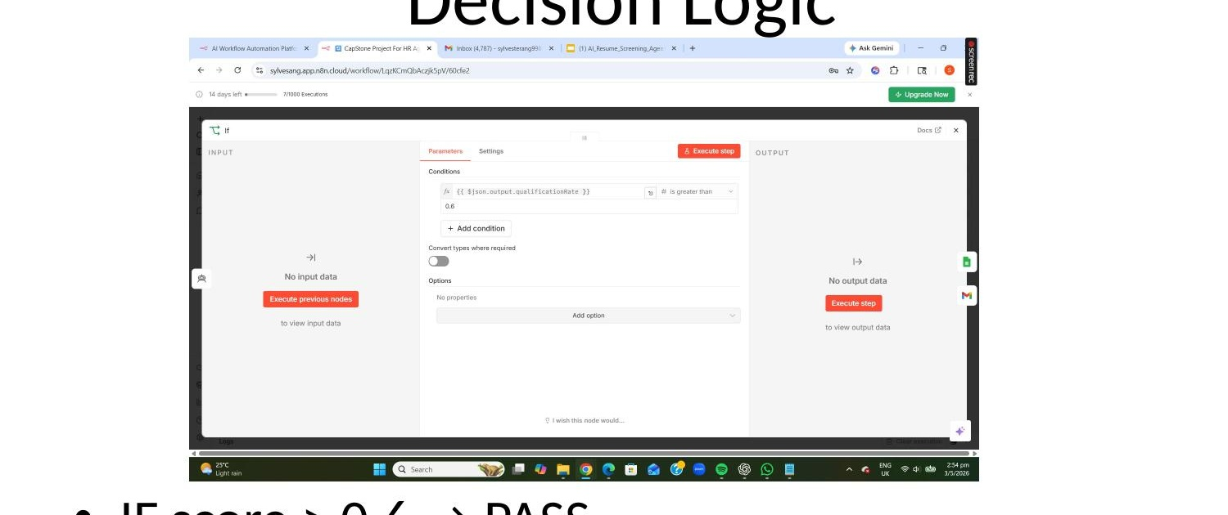
Decision Logic
Scoring Logic
Groq LLM returns JSON with score field
Score is a float between 0.0 and 1.0
0.6 is the qualification threshold
✓ PASS (score > 0.6)
✗ FAIL (score ≤ 0.6)
n8n IF node routes based on score
Log to Google Sheets
Send PASS email
Send rejection email
No Sheets entry
Both branches trigger automated actions
6

Slide 7
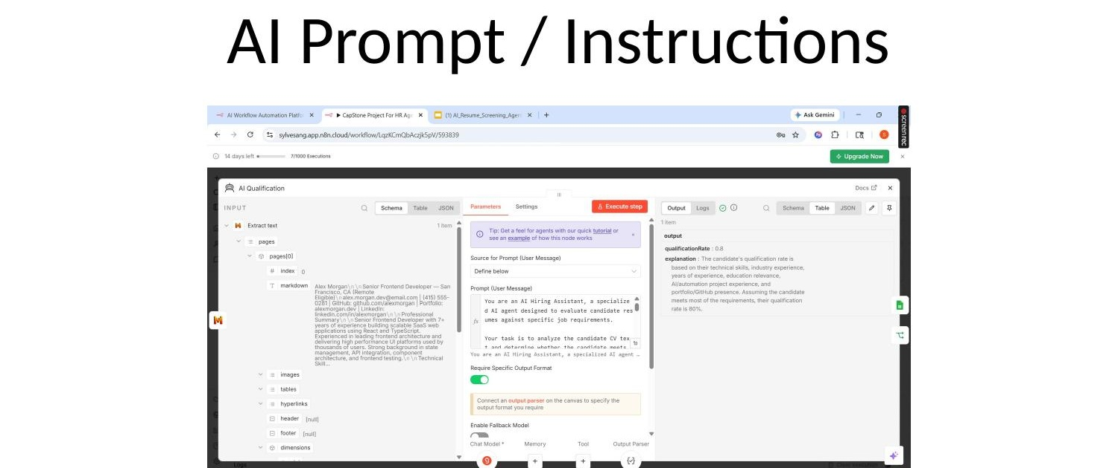
AI Prompt & Instructions
Prompt Design
HR recruiter AI persona
Evaluates CV vs job requirements
Returns qualificationRate (0–1)
Explanation for every decision
{ "qualificationRate": 0.8, "explanation": "Strong match..." }
Groq Chat Model with JSON parser
7

Slide 8
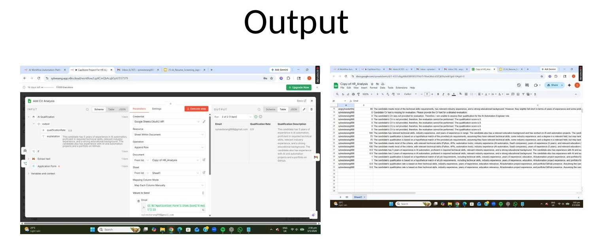
Output
Output Details
Qualified candidates logged in Sheets
Email + qualification rate + description
Rejected candidates notified by email
All results timestamped and stored
Data stored in Google Sheets + Email sent to candidate
Google Sheets
Gmail API
Zero manual data entry required
Candidate log storage
Automated email delivery
8

Slide 9
Tools Used
Tech Stack
n8n
Mistral AI
Each tool plays a specific role in the AI screening pipeline.
Workflow Orchestration
OCR — CV Text Extraction
Groq / LLM
Google Sheets
5
Tools
Integrated
AI Evaluation Engine
Candidate Data Storage
Gmail API
Automated Email Delivery
9

Slide 10
Challenges & Solutions
Key Learnings
⚠ Challenge
✓ Solution
AI workflows need robust error handling
Looping Issue
Loop Filter
n8n workflow was processing candidates in unexpected loops
Added deduplication logic and loop-break conditions
Rate limit planning is essential at scale
Iterative testing reveals edge cases early
⚠ Challenge
✓ Solution
API Rate Limits
Prompt Tuning
Modular n8n design eases debugging
Groq and Mistral API calls hitting rate limit thresholds
Optimised prompts for efficiency; added retry & delay nodes
10

Slide 11
Conclusion
AI automation improves recruitment efficiency
⚡ Automated screening reduces time-to-hire dramatically
🎯 Consistent AI scoring eliminates unconscious bias
📊 Structured data pipeline enables analytics & reporting
🔗 n8n integration bridges AI tools with business workflows
SCTP Agentic AI Capstone · Sylvester Ang

